Slide 1
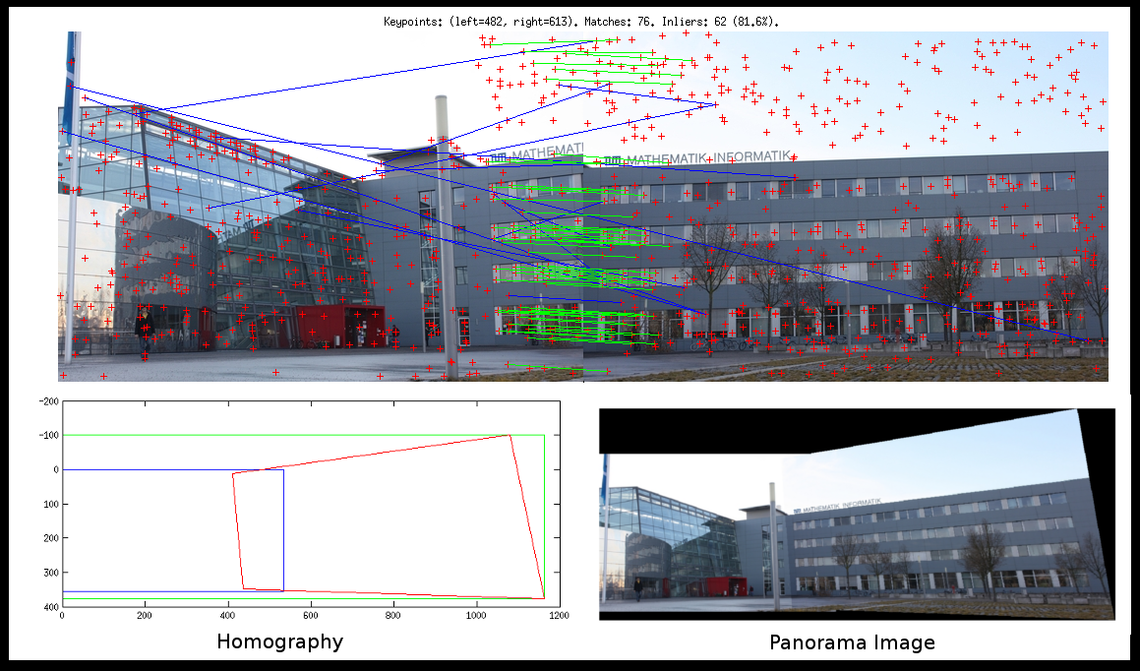
Features

Slide 2
References
http://szeliski.org/Book/
http://www.cs.cornell.edu/courses/cs5670/2019sp/lectures/lectures.html
http://www.cs.cmu.edu/~16385/
https://towardsdatascience.com/sift-scale-invariant-feature-transform-c7233dc60f37

Slide 3
contents
What and why we need features detection?
Feature detection
Blob detection
Harris corner detection
SIFT detector
Feature description
Template matching
HOG
SIFT descriptor
SIFT feature matching
Panoramas

Slide 4
What is a feature?
There is no universal or exact definition of what constitutes a feature, and the exact definition often depends on the problem or the type of application. Given that, a feature is defined as an "interesting" part of an image.
[from: Wikipedia]

Slide 5
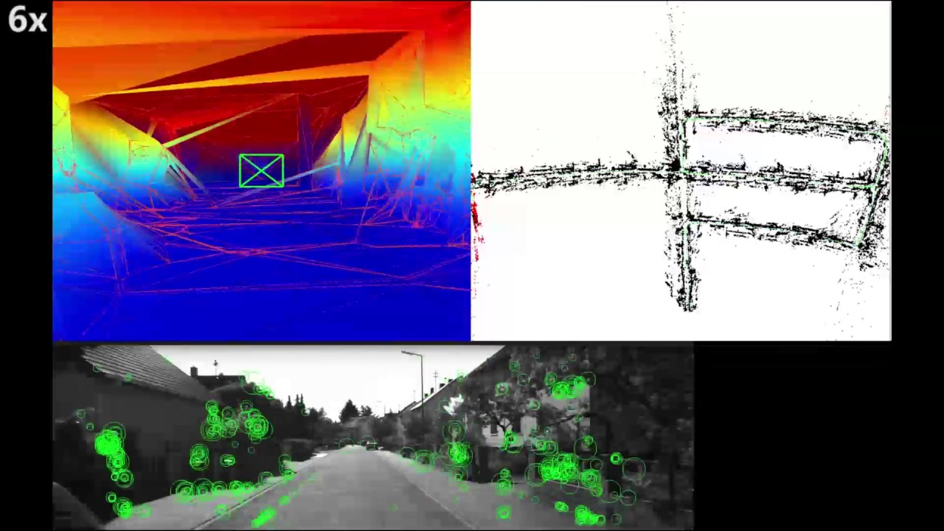
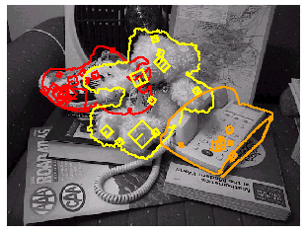
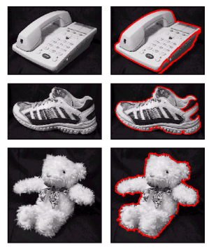
What can we do with features?
Robot navigation
Object recognition
Panorama stitching

Slide 6

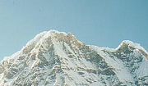
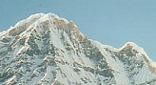
Local features: main components
1. Detection: Identify the interest points (also called keypoints).
2. Description: Extract vector feature descriptor surrounding each interest point.
3. Matching: Determine correspondence between descriptors in two views.

Slide 7
Properties of SIFT
SIFT: scale invariant feature transform.
Extraordinarily robust matching technique for local keypoint detection description and matching.
Can handle changes in viewpoint: 3D change of POV, scale, rotation and translation.
Up to about 60 degree out of plane rotation.
Can handle significant changes in illumination.
Sometimes even day vs. night.
Fast and efficient—can run in real time.

Slide 8
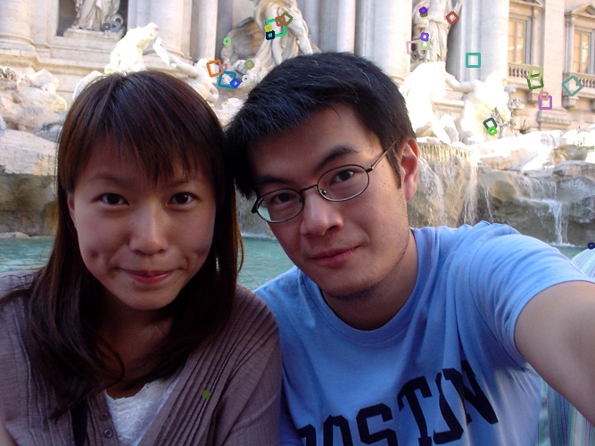
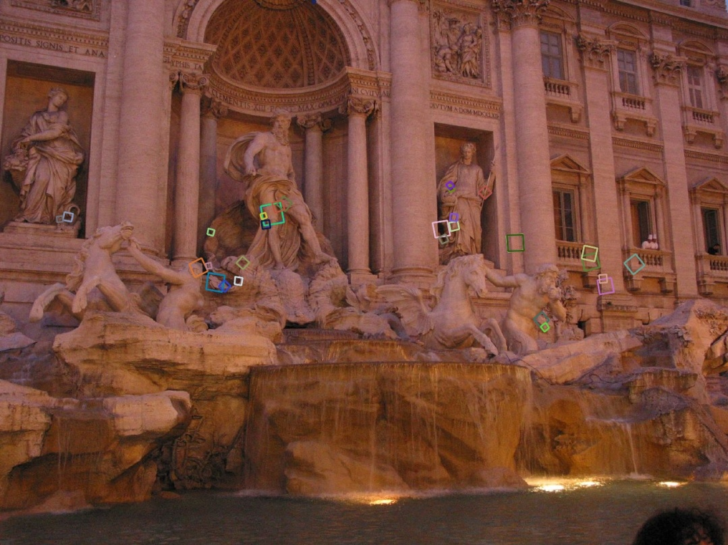
SIFT example

Slide 9
contents
What and why we need features detection?
Feature detection
Blob detection
Harris corner detection
SIFT detector
Feature description
Template matching
HOG
SIFT descriptor
SIFT feature matching
Panoramas

Slide 10
Advantages of local keypoints
Locality:
features are local, so robust to occlusion and clutter => invariance to 3D change of viewpoint.
Quantity:
hundreds or thousands in a single image
Distinctiveness:
can differentiate a large database of objects
Efficiency
real-time performance achievable

Slide 11
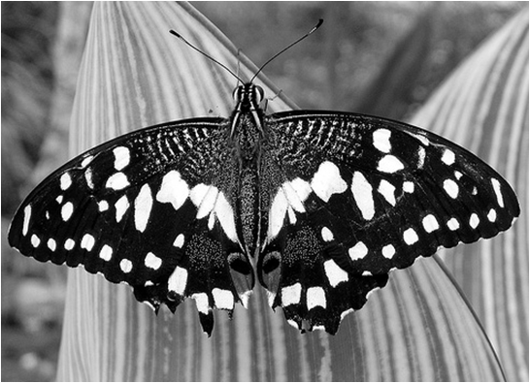
keypoints
Keypoints should be a unique point of the image where all close neighbors are very different from.
First attempt: lets take a blob in the image which has a very different surrounding, and this will be our keypoint.

Slide 12
contents
What and why we need features detection?
Feature detection
Blob detection
Harris corner detection
SIFT detector
Feature description
Template matching
HOG
SIFT descriptor
SIFT feature matching
Panoramas

Slide 13
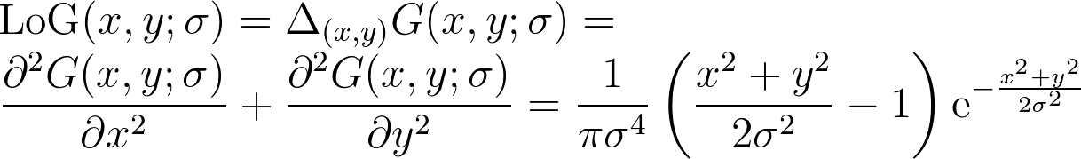
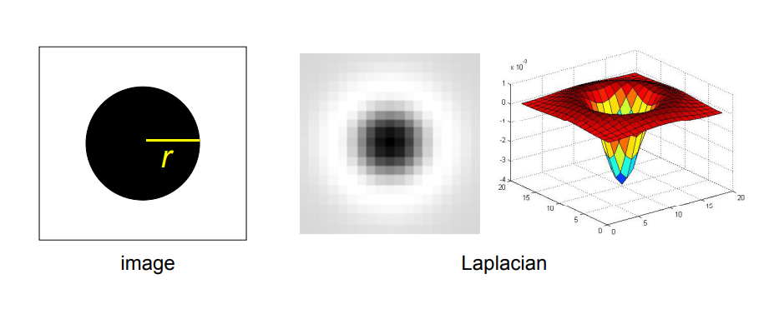
Blob detection
Essentially cross correlation- we are convolving a signal with a template of a LoG (Laplacian of Gaussian) to get the highest response when the template matches the signal.
Notes:
\\
{\rm LoG}(x,y;\sigma)
=
\Delta_{(x,y)}G(x,y;\sigma)
=
\\
\frac{\partial^2 G(x,y;\sigma)}{\partial x^2} + \frac{\partial^2 G(x,y;\sigma)}{\partial y^2}
=
\frac{1}{\pi\sigma^4} \left(\frac{x^2+y^2}{2\sigma^2}-1\right){\rm e}^{-\frac{x^2+y^2}{2\sigma^2}}

Slide 14
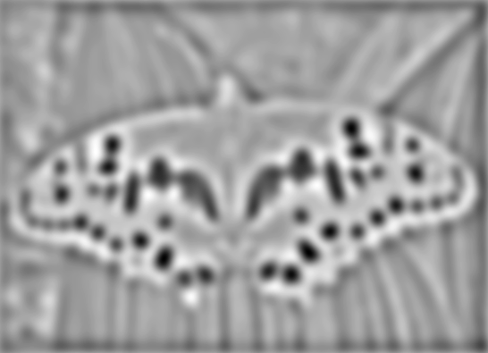

Blob detection
Find maxima and minima of LoG operator in space and scale
minima
*
=
maximum

Slide 15
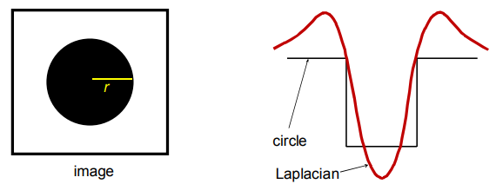
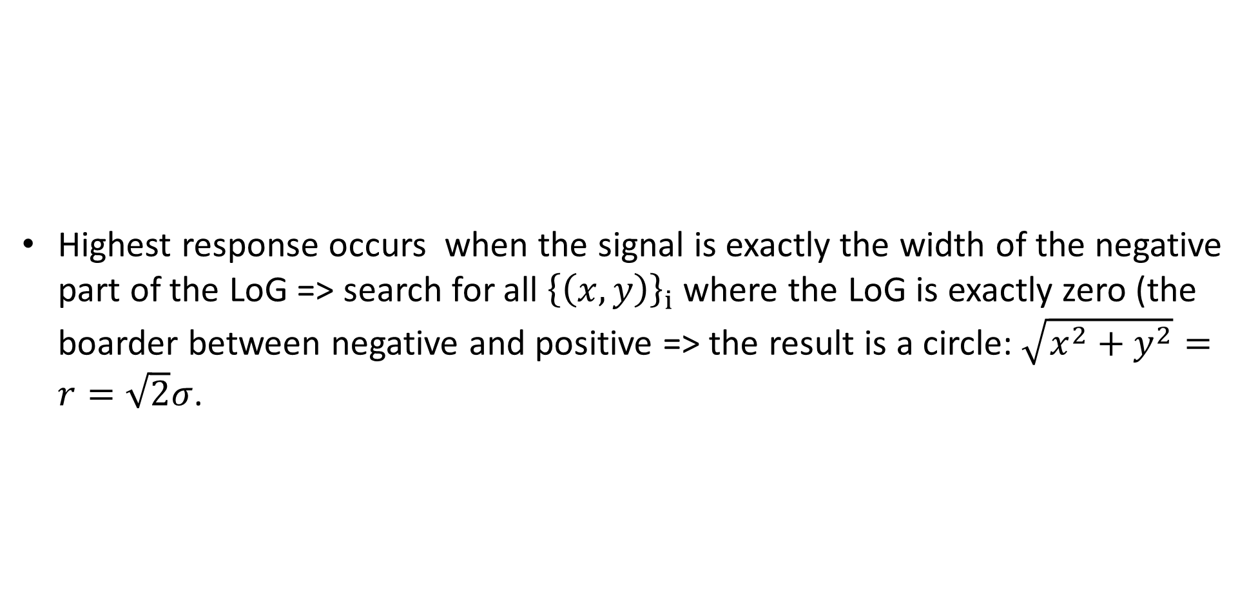
Blob detection
Highest response occurs when the signal is exactly the width of the negative part of the LoG => search for all ${\left\{\left(x,y\right)\right\}}_{i}$ where the LoG is exactly zero (the boarder between negative and positive => the result is a circle: $\sqrt{x^{2}+y^{2}}=r=\sqrt{2}σ$.
0
Notes:
\\
{\rm LoG}(x,y;\sigma)
=
\Delta_{(x,y)}G(x,y;\sigma)
=
\\
\frac{\partial^2 G(x,y;\sigma)}{\partial x^2} + \frac{\partial^2 G(x,y;\sigma)}{\partial y^2}
=
\frac{1}{\pi\sigma^4} \left(\frac{x^2+y^2}{2\sigma^2}-1\right){\rm e}^{-\frac{x^2+y^2}{2\sigma^2}}

Slide 16
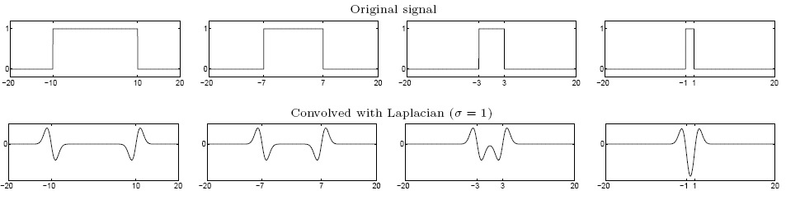
Blob detection
Laplacian filter
Highest absolute response when the signal has the same characteristic scale as the filter

Slide 17
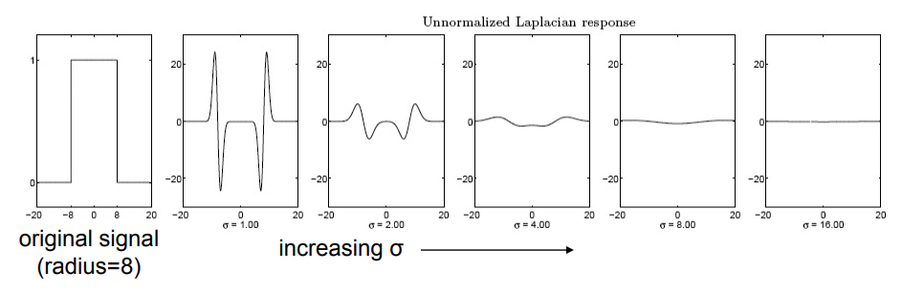
Blob detection- normalized LoG
We want to find the characteristic scale of the blob by convolving it with LoGs at several scales and looking for the maximum response.
However, LoG response decays as scale increases.

Slide 18
Blob detection- normalized LoG
We want that the maximum of the LoG will be always at the same value, so we are using the scale normalized LoG:
Full derivation is available here: http://www.cim.mcgill.ca/~langer/558/2009/lecture11.pdf
Notes:
\\
{\rm normLoG}(x,y;\sigma)
=
\sigma^2\Delta_{(x,y)}G(x,y;\sigma)
=
\sigma^2\left ( \frac{\partial^2 G(x,y;\sigma)}{\partial x^2} + \frac{\partial^2 G(x,y;\sigma)}{\partial y^2}
\right )

Slide 19
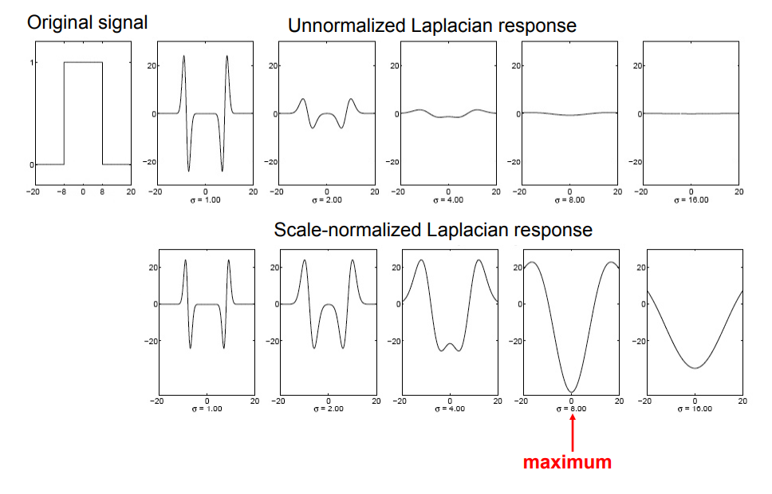
Blob detection- normalized LoG

Slide 20
Blob detection- normalized LoG
An example of max responses:

Slide 21
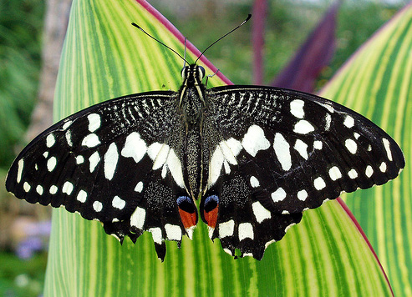

Slide 22
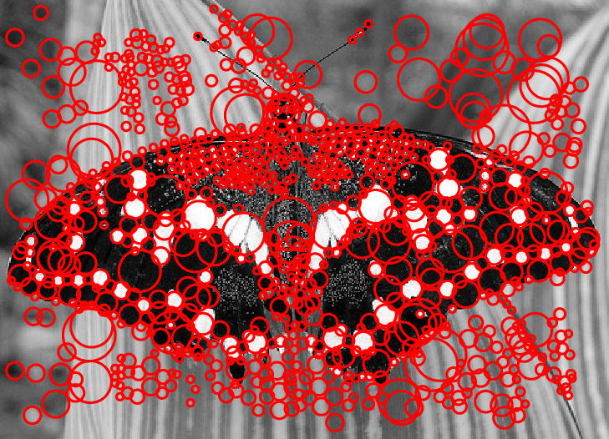

Slide 23
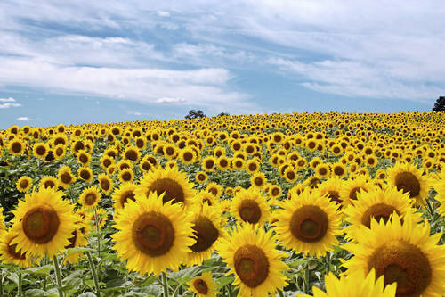
Normalized LoG – scale invariance
Blob detection is invariance to scale.
Full size
3/4 size

Slide 24
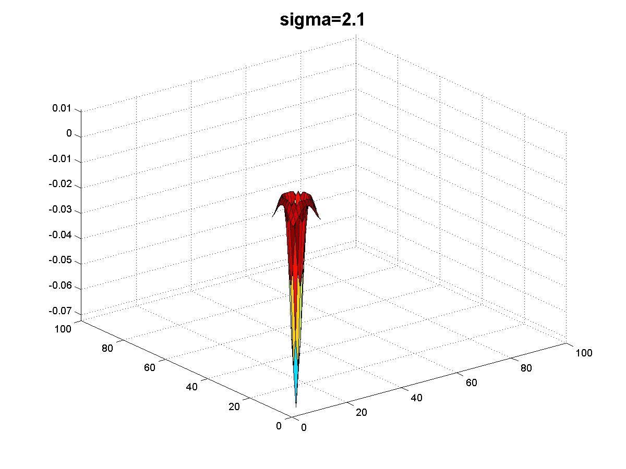
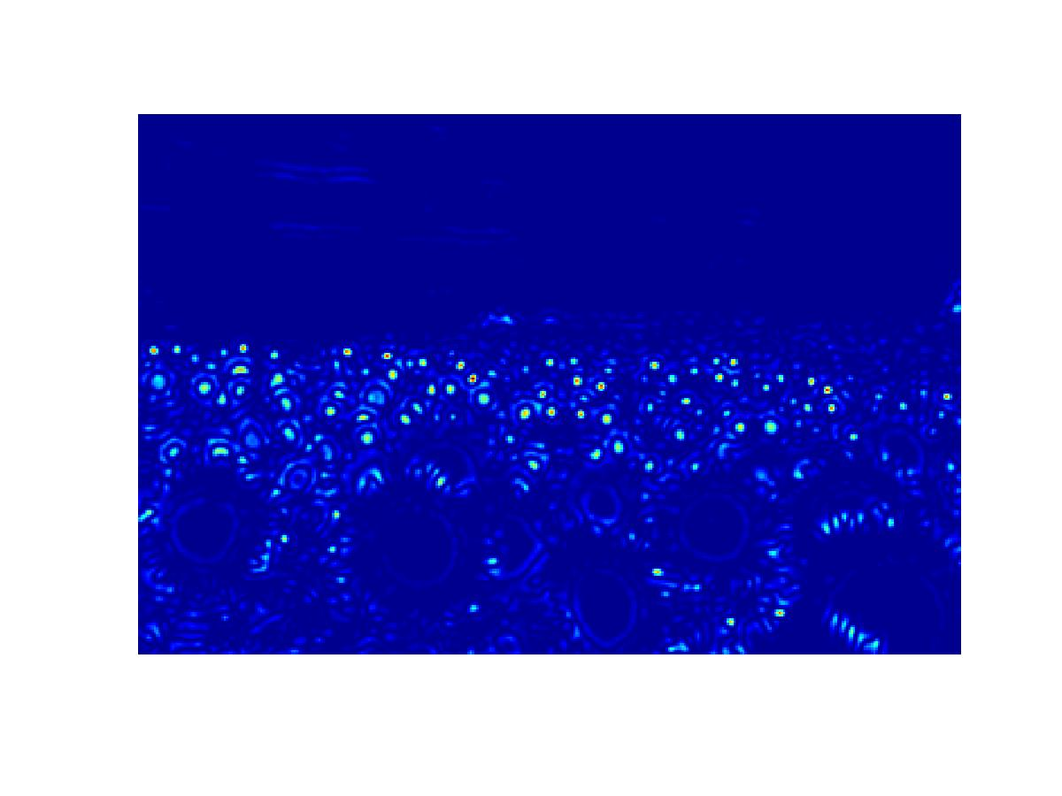
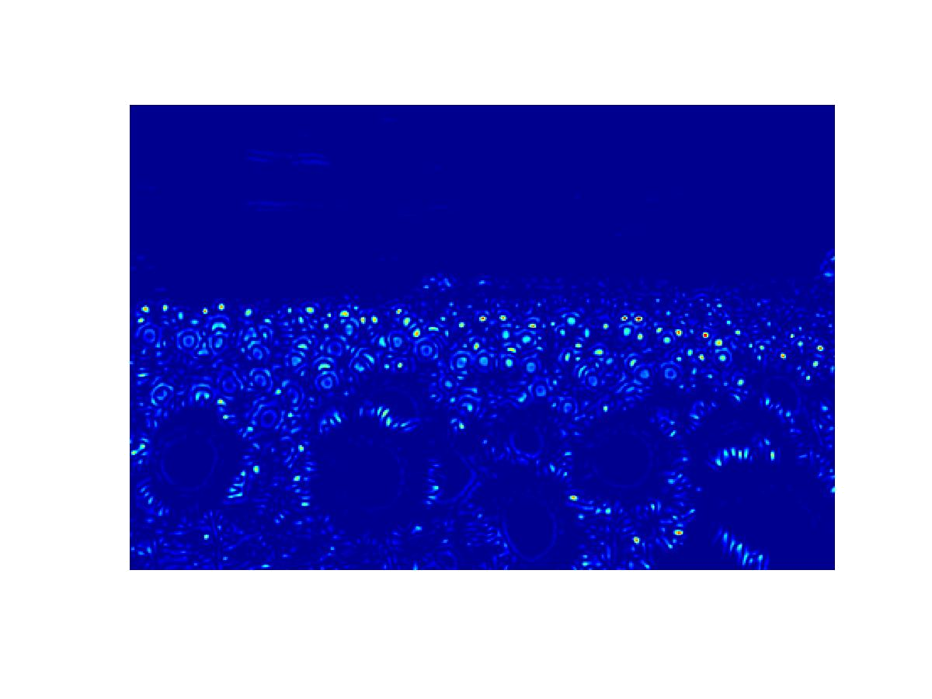

Slide 25
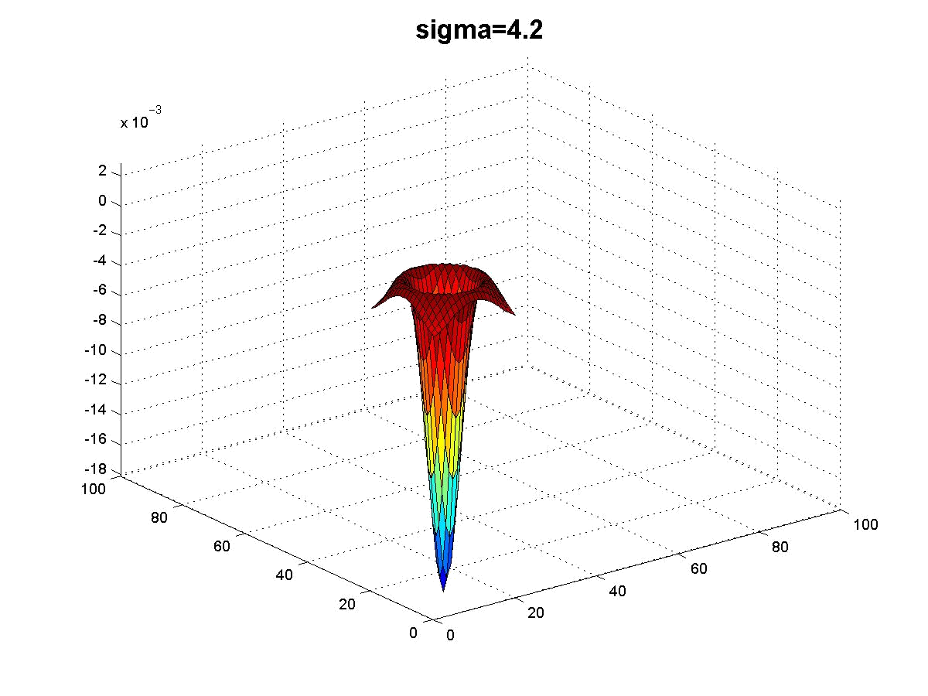
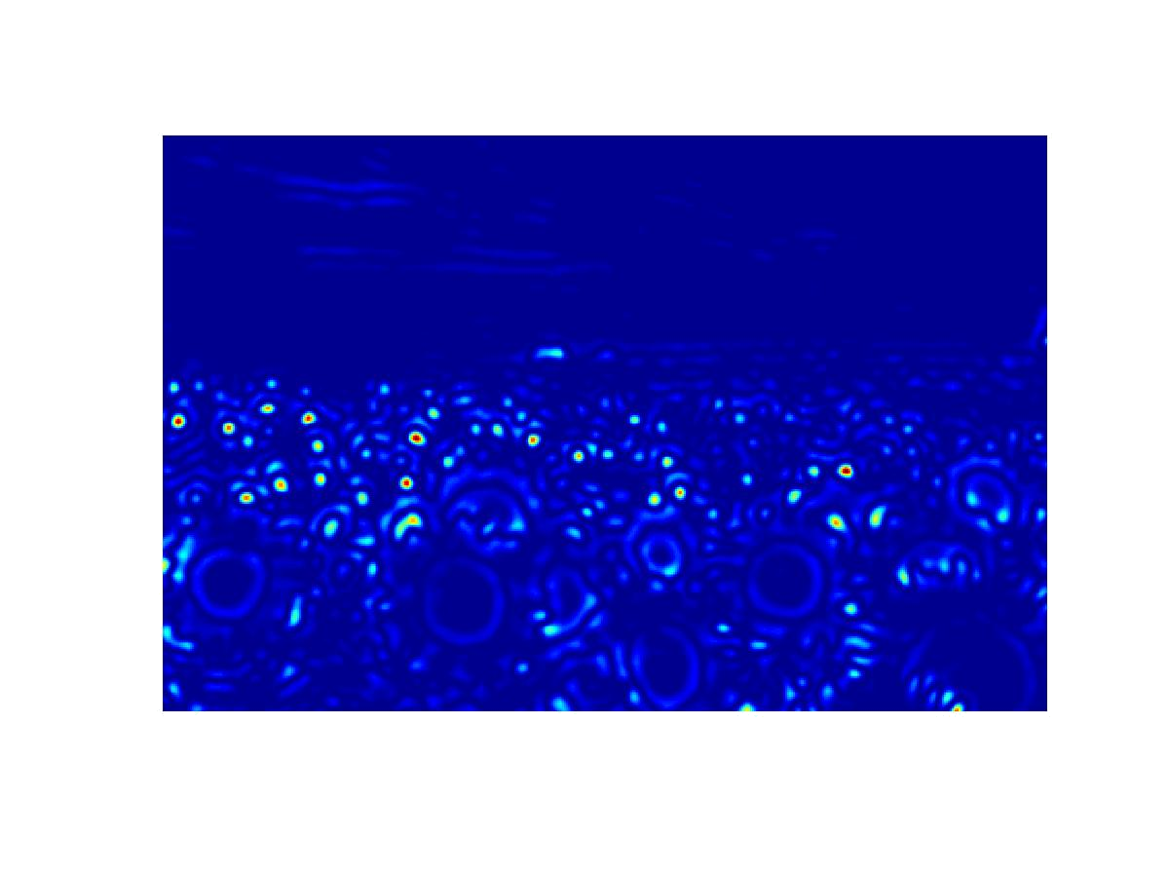
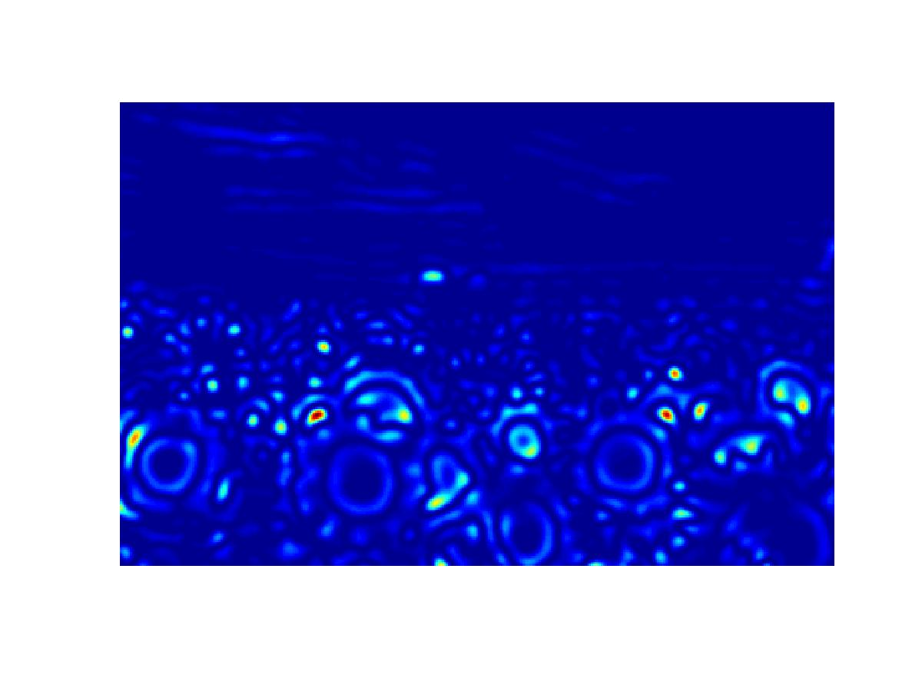

Slide 26
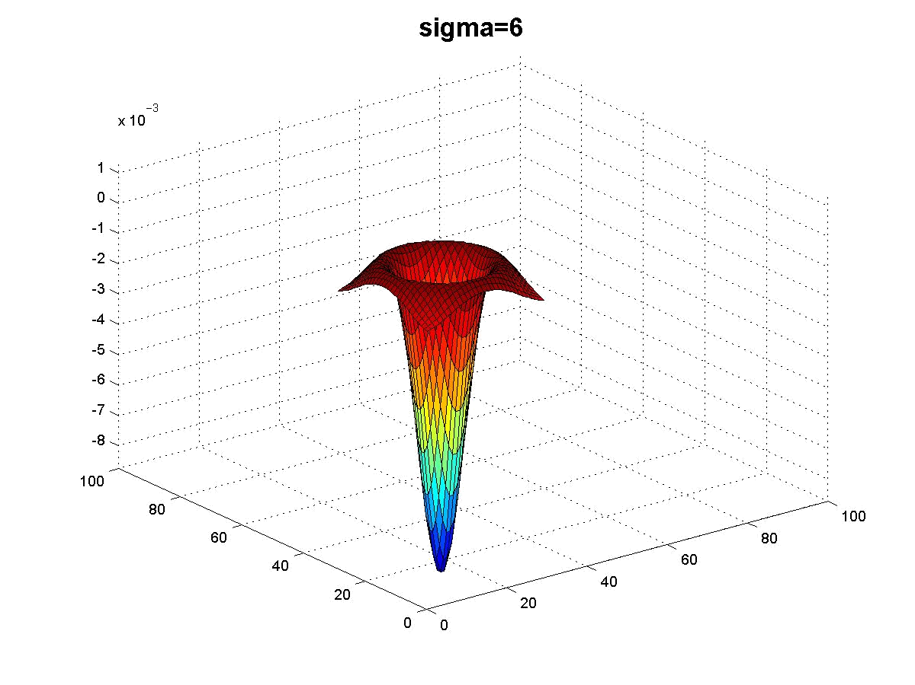
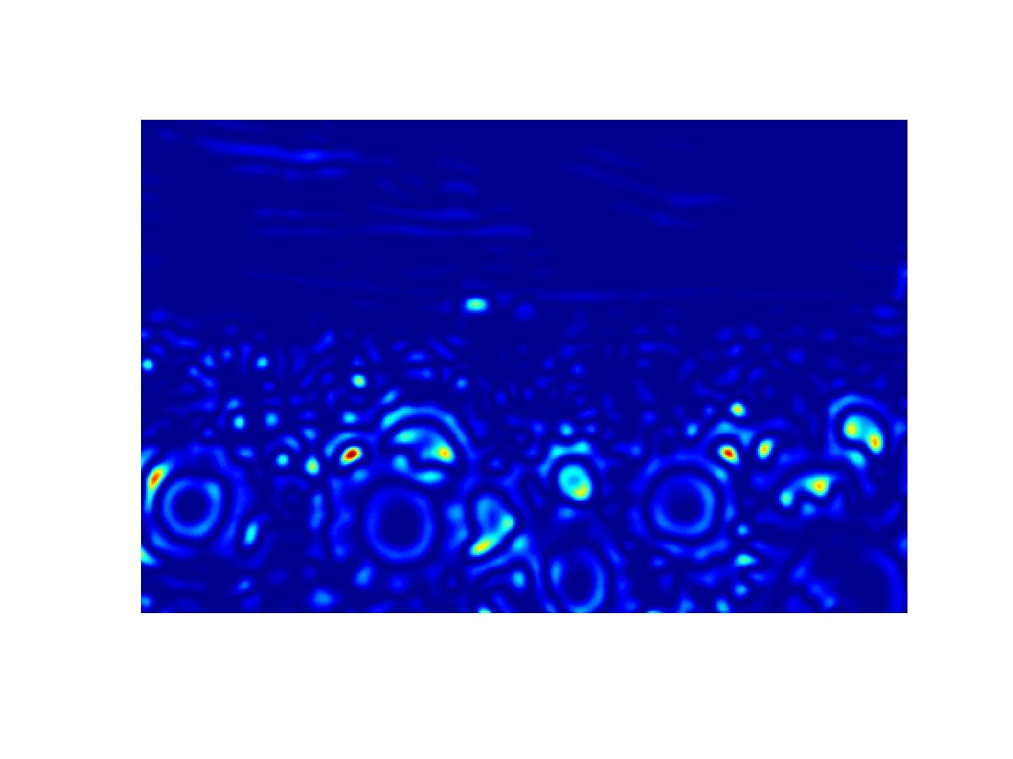
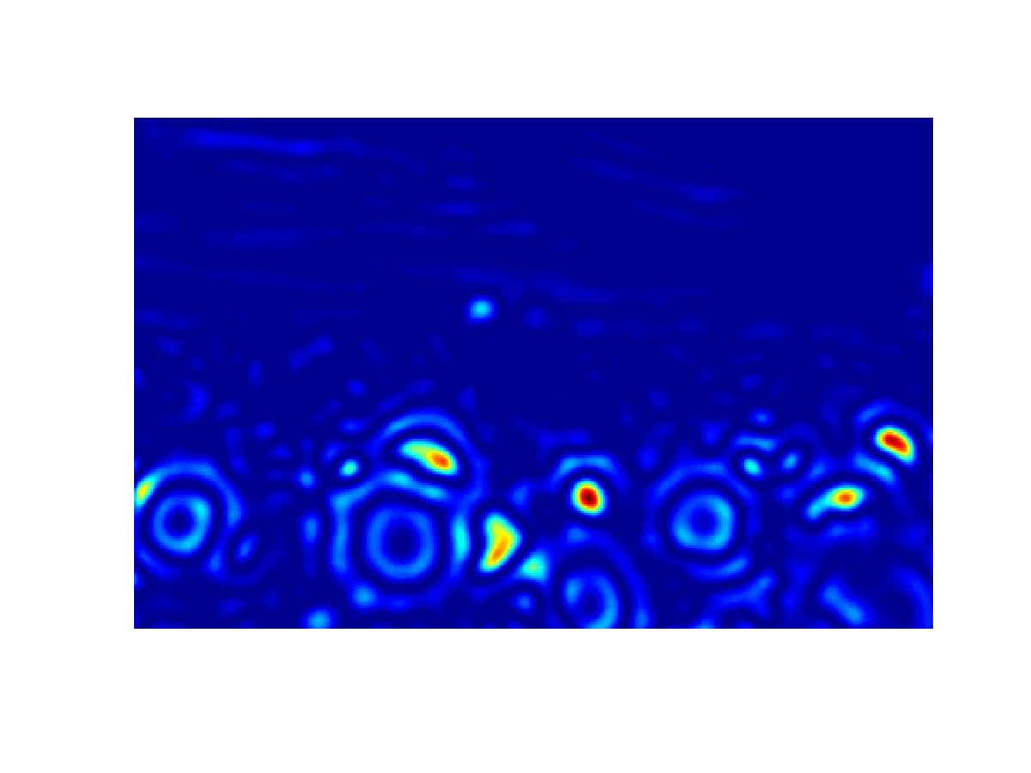
peak!

Slide 27
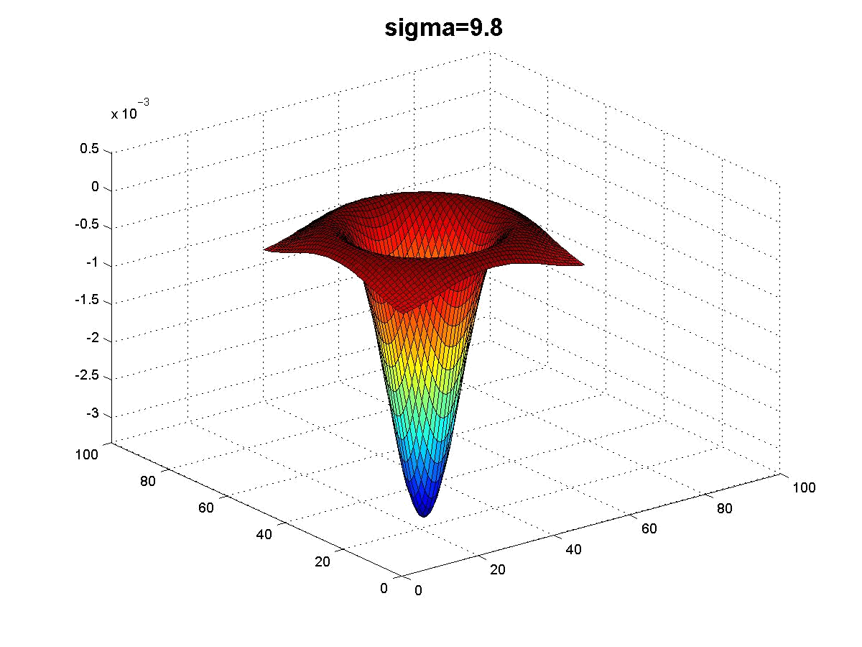
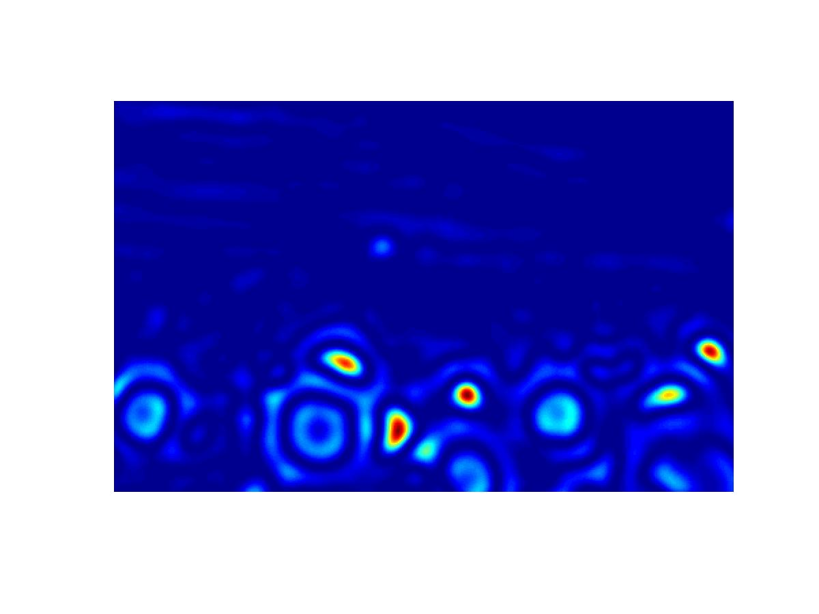
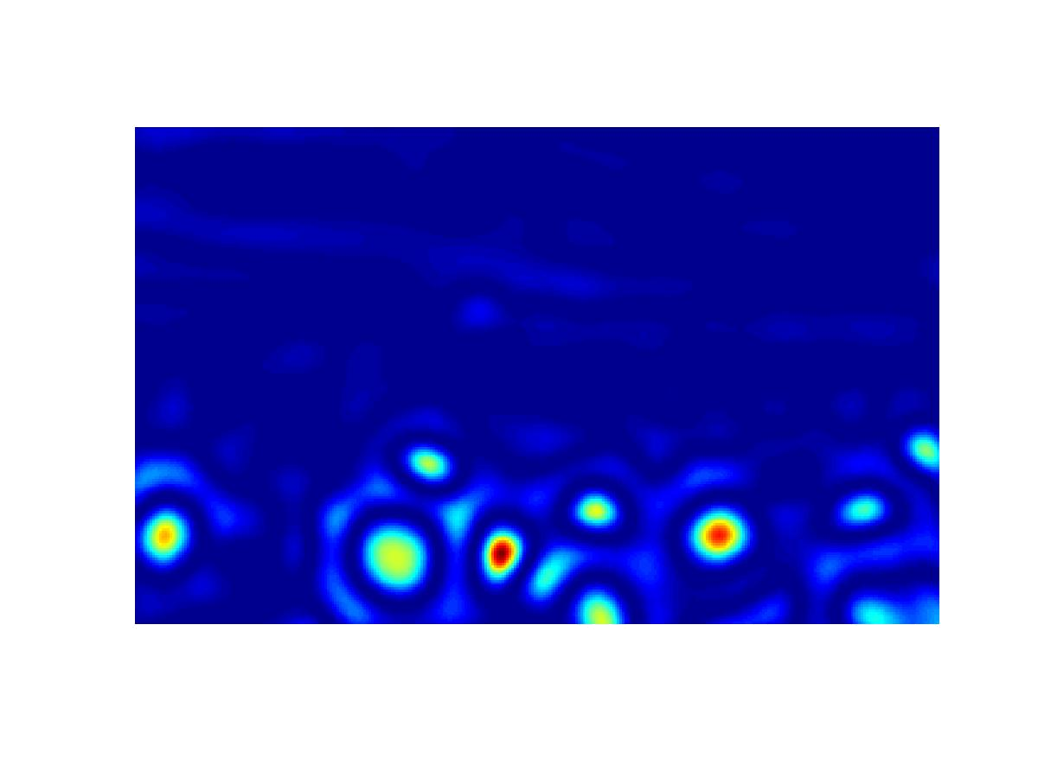
peak!

Slide 28
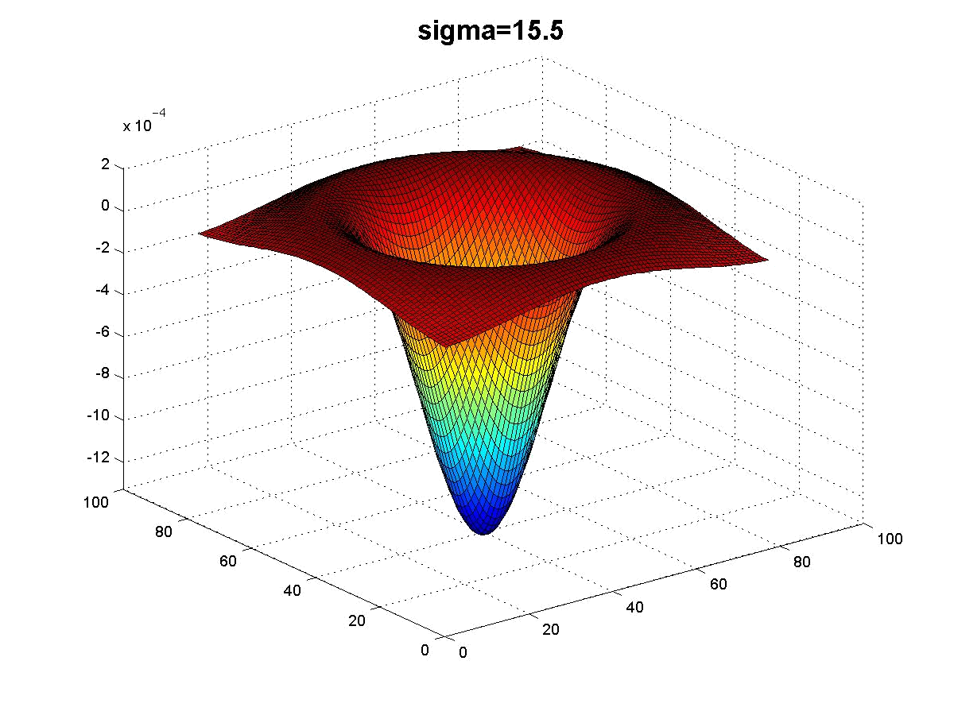
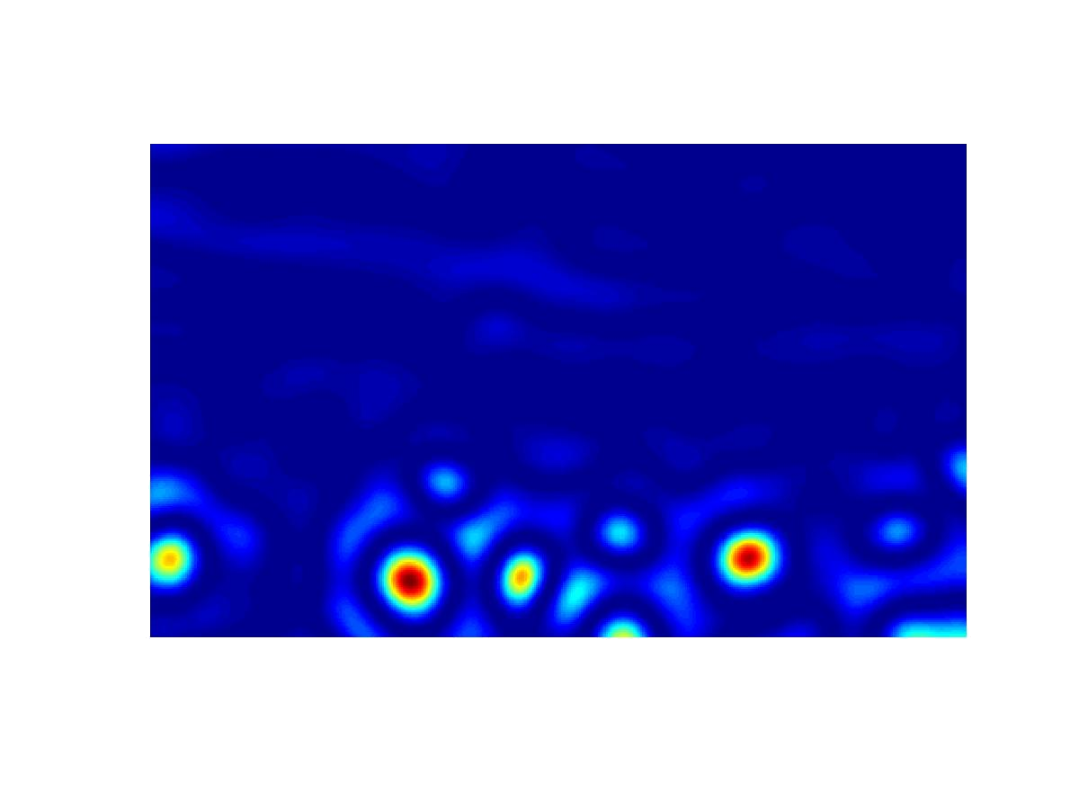
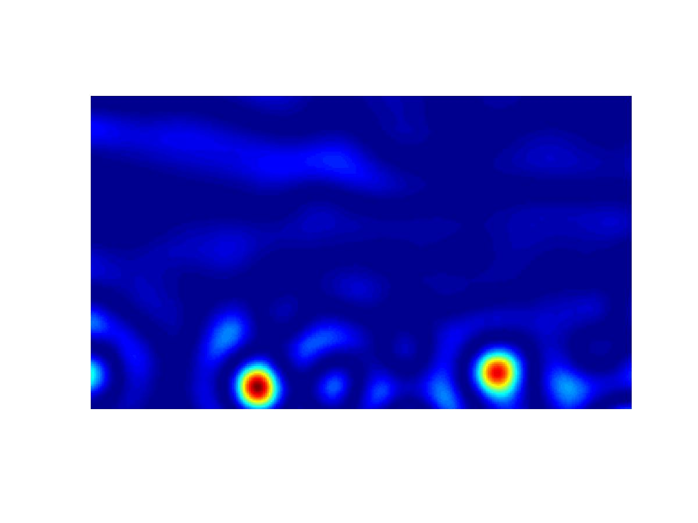

Slide 29
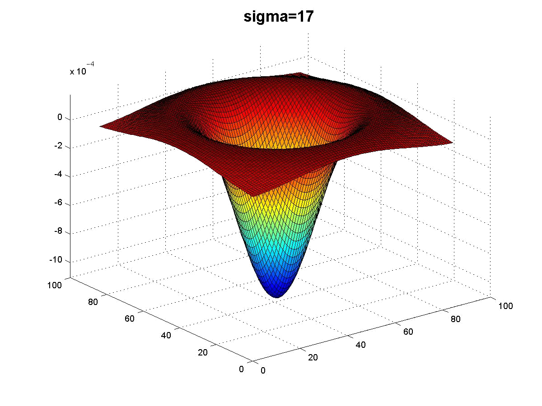
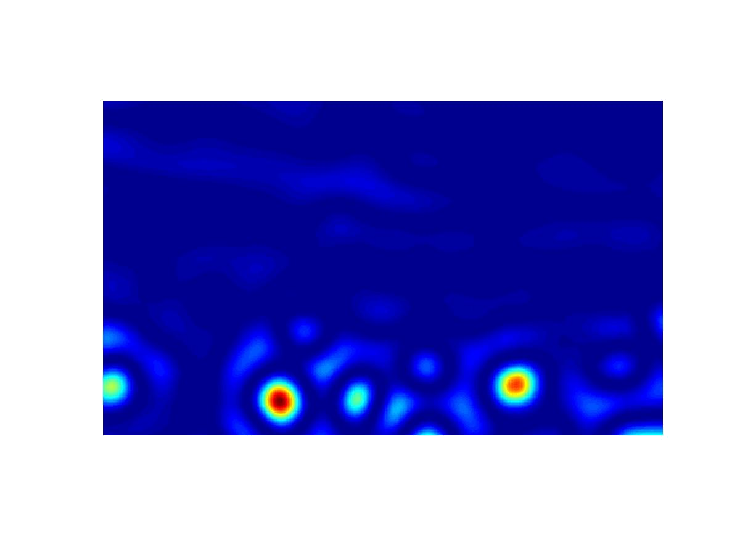
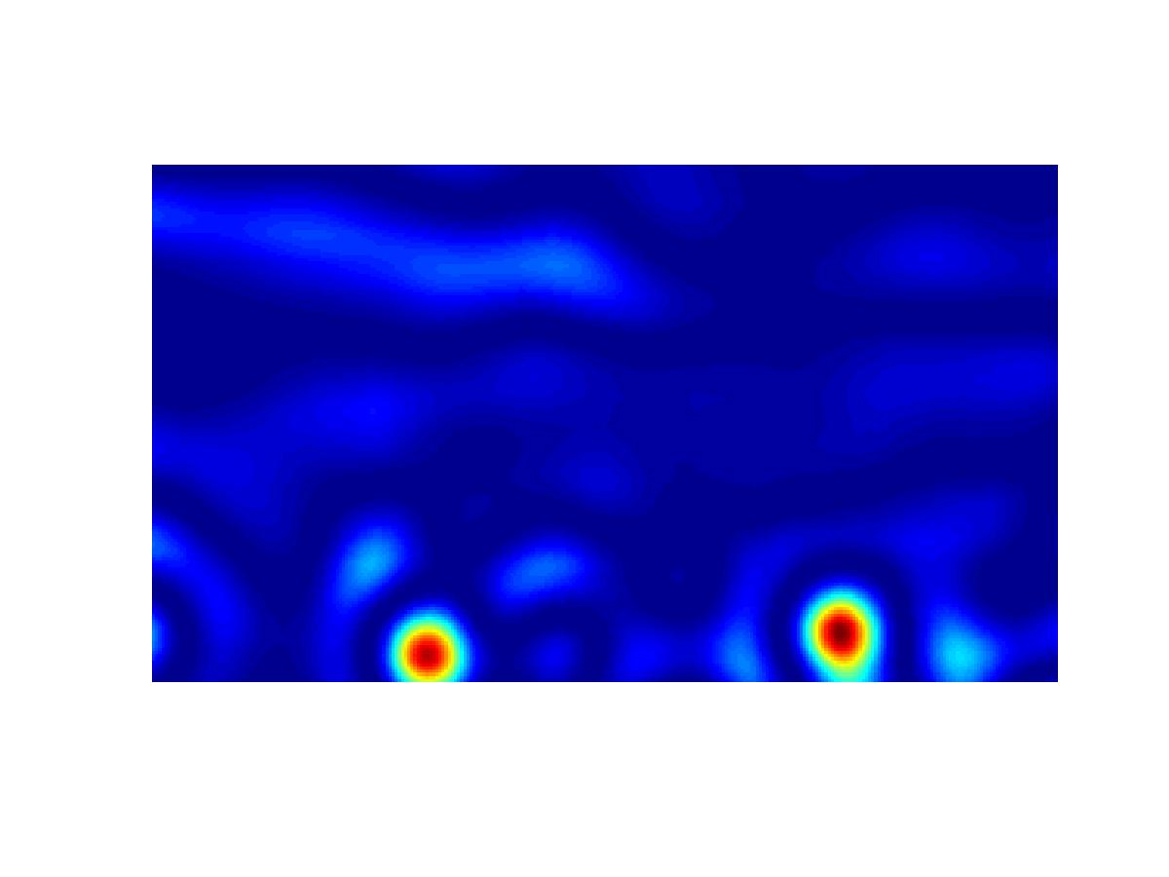

Slide 30
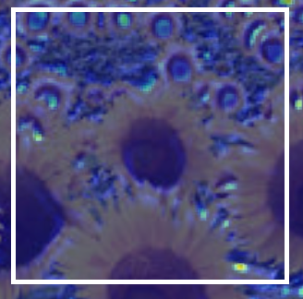
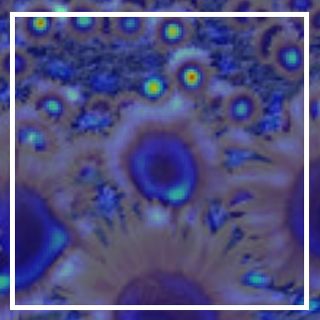
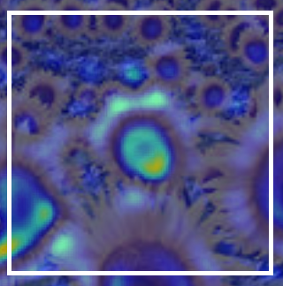
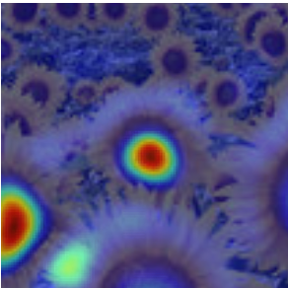
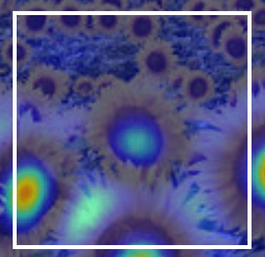
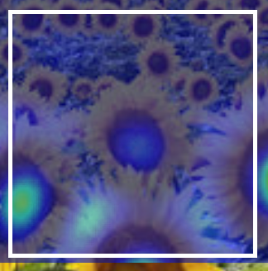
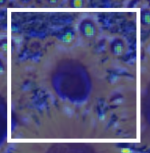
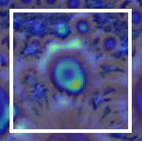
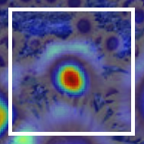
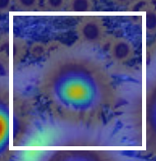
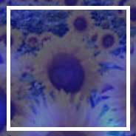
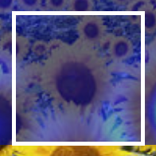
Normalized LoG – optimal scale
2.1
4.2
6.0
9.8
15.5
17.0
Full size image
2.1
4.2
6.0
9.8
15.5
17.0
3/4 size image

Slide 31
Normalized LoG – optimal scale
2.1
4.2
6.0
9.8
15.5
17.0
maximum response
Full size image
2.1
4.2
6.0
9.8
15.5
17.0
maximum response
3/4 size image

Slide 32
Normalized LoG – optimal scale
4.2
cross-scale maximum
local maximum
6.0
9.8

Slide 33


As seen in class- edges: DoG
Can also use difference of Gaussians (DoG) to mimic LoG.
Why do we want to do this? Faster computationally (explained here: https://dsp.stackexchange.com/a/37675 )

Slide 34


Slide 35


Blob detection algorithm
Build DoG images.
Search across different image scales for the max response.

Slide 36

Reminder: Gaussian pyramid

Slide 37


Improved LoG blob detector
Since the images is low-passed filter so much, we can decimate the image and not loose data in the process!
We can build a Gaussian pyramid (as taught in image processing recap class) and run the entire algorithm on the different octave scales.
When using different octave scales we can get features from different image scale.

Slide 38

Blob detection: summary
Advantages:
Invariant to translation, rotation, scale and intensity shift $I→I+b$ (because we use only the derivatives: $\left(∇G\right)∗I=∇\left(G∗I\right)=G∗(∇I)$).
Disadvantages:
Can also match edges, not just corners (why it’s matter? Now)

Slide 39
contents
What and why we need features detection?
Feature detection
Blob detection
Harris corner detection
SIFT detector
Feature description
Template matching
HOG
SIFT descriptor
SIFT feature matching
Panoramas

Slide 40
keypoints
Keypoints should be a unique point of the image where all close neighbors are very different from.
Atempt 2: lets find corners in edge image- they are unique because their surrounding are very different.

Slide 41


Harris corner detection
Consider shifting the window W by (u,v)
compare each pixel before and after by summing up the squared differences (SSD).
this defines an SSD “error” $E(u,v)$:
We are happy if this error is high for all $(u,v)≠(0,0)$
_{(u,v)}
W

Slide 42
Local measures of uniqueness
Suppose we only consider a small window of pixels.
How does the window change when you shift it?
Credit: S. Seitz, D. Frolova, D. Simakov
Notes:
High level idea is that corners are good. You want to find windows that contain strong gradients AND gradients oriented in more than one direction

Slide 43
Local measures of uniqueness
Suppose we only consider a small window of pixels.
How does the window change when you shift it?
“flat” region: no change in all directions
“edge”:
no change along the edge direction
“corner”: significant change in all directions

Slide 44




Harris corner detection
Taylor Series expansion of $I$:
If the motion $(u,v)$ is small, then first order approximation is good
Plug it into the SSD error term:

Slide 45







Harris corner detection
Also called second-moments matrix
E(u,v)
v
u

Slide 46



Harris corner detection
E(u,v)
Horizontal edge:
v
u

Slide 47



Harris corner detection
E(u,v)
Vertical edge:
v
u

Slide 48

Harris corner detection: probabilistic interpretation
A real symmetric matrix has an eigendecomposition of:
Bonus: eigenvectors are orthonormal if A is real and symmetric.
Notes:
\\
Av = \lambda v
\\
AQ=Q\Lambda
\\
A=Q\Lambda Q^{-1}
\\
\xrightarrow{\text{A is real symmetric matrix}}
\\
A=Q\Lambda Q^{T}
\\
A=\left(\begin{array}{ll}{e_{1}} & {e_{2}}\end{array}\right)\left(\begin{array}{cc}{\lambda_{1}} & {0} \\ {0} & {\lambda_{2}}\end{array}\right)\left(\begin{array}{c}{e_{1}^{T}} \\ {e_{2}^{T}}\end{array}\right)

Slide 49



Harris corner detection
An ellipse can have a matrix form of:
Which is exactly as a rotated ellipse with a center of $\left(0,0\right):$
Notes:
\\
x^{T}\left(e_{1} e_{2}\right)\left(\begin{array}{cc}{\lambda_{1}} \\ {} & {\lambda_{2}}\end{array}\right)\left(\begin{array}{c}{e_{1}^{T}} \\ {e_{2}^{T}}\end{array}\right) x=1
\\
\lambda_{1} x^{T} e_{1} e_{1}^{T} x+\lambda_{2} x^{T} e_{2} e_{2}^{T} x =1
\\
\frac{\left(e_{1}^{T} x\right)^{2}}{\left(\frac{1}{\sqrt{\lambda_{1}}}\right)^{2}}+\frac{\left(e_{2}^{T} x\right)^{2}}{\left(\frac{1}{\sqrt{\lambda_{2}}}\right)^{2}}=1
=============================================
\frac{(x \cos (\theta)+y \sin (\theta))^{2}}{a^2}+\frac{(x \sin (\theta)-y \cos (\theta))^2}{b^{2}}=1

Slide 50




Harris corner detection
Combining the two equations seen before we can conclude that when taking a cross-section from the error function, we can get an ellipsoid.
$[u v]H\left[\begin{matrix}u \\ v\end{matrix}\right]=\text{const}$
Assume $λ_{1}>λ_{2}$
direction of $e_{max}$
direction of $e_{min}$
(λ_{max})^{-1/2}
(λ_{min})^{-1/2}

Slide 51



Harris corner detection
Eigenvalues and eigenvectors of $H$
$e_{1}$ = direction of largest increase in $E$
$1$= relative increase in direction $e_{1}$
$e_{2}$ = direction of smallest increase in $E$
$2⁡$= relative increase in direction $e_{2}$
$λ larger↔λ^{−\frac{1}{2}} smaller↔faster change in E\left(u,v\right) in e direction$
$e_{min}$
$e_{max}$
direction of $e_{max}$
direction of $e_{min}$
(λ_{max})^{-1/2}
(λ_{min})^{-1/2}

Slide 52

Interpreting the eigenvalues
A “good” corner will have a large $R=λ_{min}$, which means big change of $E$in both axis.
Getting the eigenvectors and eigenvalues is computationally inefficient.
Instead, use two tricks:
$\prod_{i}{λ_{i}}=\det\left(A\right)$
$\sum_{i}{λ_{i}=trace(A)}$
Then we can more easily compute $R≈λ_{min}$ :
$R=\det\left(A\right)−κ∗trace{\left(A\right)}^{2}$ $(κ∈[0.04, 0.06])$
$R=\frac{\det\left(A\right)}{trace\left(A\right)}=\frac{λ_{1}λ_{2}}{λ_{1}+λ_{2}}$

Slide 53
Interpreting the eigenvalues
λ₂
“Edge” λ₂ >> λ₁
“Corner” λ₁ and λ₂ are large, λ₁ ~ λ₂; E increases in all directions
λ₁ and λ₂ are small; E is almost constant in all directions
“Flat” region
“Edge” λ₁ >> λ₂
λ₁

Slide 54







Interpreting the eigenvalues
A binary threshold of pixels above $λ_{max}$ and $λ_{min}$

Slide 55
Harris corner detection
Compute gradients of patch around each pixel.
Subtract the mean from each patch gradient.
Compute the second-moment matrix.
Compute eigendecomposition of covariance matrix.
Use eigenvalues to find corners.
This is PCA (principal component analysis). Out of scope but really interesting!

Slide 56

Harris detector example

Slide 57

f value (red high, blue low)

Slide 58

Threshold (f > value)

Slide 59

Find local maxima of f

Slide 60

Harris features (in red)

Slide 61



Weighting the derivatives
In practice, using a simple window W doesn’t work too well
Instead, we’ll weight each derivative value based on its distance from the center pixel

Slide 62
Harris corner detector- rotation and translation
Ellipse rotates but its shape (eigenvalues) remains the same => invariant to rotation!
The feature is also translation invariant (easy to see).

Slide 63

Harris corner detector- intensity
Partial invariance to affine intensity change
Only derivatives are used => invariance to intensity shift $I→I+b$
Not completely invariance to Intensity scale: $I → a∙I$
R
R
threshold
x (image coordinate)
x (image coordinate)

Slide 64


The Harris corner detector is not invariant to scale
edge!
corner!

Slide 65
contents
What and why we need features detection?
Feature detection
Blob detection
Harris corner detection
SIFT detector
Feature description
HOG
SIFT descriptor
SIFT feature matching
Panoramas

Slide 66
SIFT keypoint detection
SIFT has the advantages of both previous technics and is invariance to: rotation, translation, scale, illumination shift and partially to 3D change of viewpoint since it is a local keypoint detector.
Find blobs using the improved blob detection (across different octave scale).
Use interpolation to find exact peak of keypoint.
The interpolation takes place in x, y and scale dimension.
Eliminate edge response with Harris corner detector variant (called principal curvature) around temp keypoints in interpolated space and scale.

Slide 67
contents
What and why we need features detection?
Feature detection
Blob detection
Harris corner detection
SIFT detector
Feature description
Template matching
HOG
SIFT descriptor
SIFT feature matching
Panoramas

Slide 68

Find this template
How do we detect the template in he following image?

Slide 69

Find this template
How do we detect the template in he following image?
filter
output
What will the output look like?
image
Solution 1: Filter the image using the template as filter kernel.

Slide 70

Find this template
How do we detect the template in he following image?
filter
output
image
Solution 1: Filter the image using the template as filter kernel.
What went wrong?

Slide 71
Find this template
How do we detect the template in he following image?
filter
output
image
Increases for higher local intensities.
Solution 1: Filter the image using the template as filter kernel.

Slide 72

Find this template
How do we detect the template in he following image?
filter
template mean
output
What will the output look like?
image
Solution 2: Filter the image using a zero-mean template.

Slide 73


Find this template
How do we detect the template in he following image?
output
filter
template mean
output
True detection
thresholding
image
False detections
Solution 2: Filter the image using a zero-mean template.
What went wrong?

Slide 74
Find this template
How do we detect the template in he following image?
output
filter
template mean
output
Not robust to high-contrast areas
image
Solution 2: Filter the image using a zero-mean template.

Slide 75
Can construct the above equation to a regular cross correlation and a sum of the image patch times minus the average patch.
a sum of the image patch times minus the average patch == 0 if this is a high contract region (half 1 half 0),
Why without the mean of the image patch?????

Slide 76

Find this template
How do we detect the template in he following image?
filter
output
What will the output look like?
image
Solution 3: Use sum of squared differences (SSD).

Slide 77


Find this template
How do we detect the template in he following image?
1-output
filter
output
True detection
thresholding
image
Solution 3: Use sum of squared differences (SSD).
What could go wrong?

Slide 78


Find this template
How do we detect the template in he following image?
1-output
filter
output
Not robust to local intensity changes
image
Solution 3: Use sum of squared differences (SSD).

Slide 79
Find this template
How do we detect the template in he following image?
Observations so far:
subtracting mean deals with brightness bias
dividing by standard deviation removes contrast bias
Can we combine the two effects?

Slide 80

Find this template
How do we detect the template in he following image?
What will the output look like?
filter
template mean
output
local patch mean
image
Solution 4: Normalized cross-correlation (NCC).

Slide 81


Find this template
How do we detect the template in he following image?
1-output
True detections
thresholding
Solution 4: Normalized cross-correlation (NCC).

Slide 82

Find this template
How do we detect the template in he following image?
1-output
True detections
thresholding
Solution 4: Normalized cross-correlation (NCC).

Slide 83
What is the best method?
It depends on whether you care about speed or invariance.
Zero-mean: Fastest, very sensitive to local intensity.
Sum of squared differences: Medium speed, sensitive to intensity offsets.
Normalized cross-correlation: Slowest, invariant to contrast and brightness.

Slide 84


SSD
Sum of squared distances.
Use the whole patch as a template and find best match in other image.
$d=\sum{{\left|\left|x_{i}−y_{i}\right|\right|}^{2}}$

Slide 85

SSD
Not good enough for light changes

Slide 86
Cross correlation
Convolution without the flipping of the kernel in x and y directions.
Pretty much the same

Slide 87

NCC
NCC: Normalized cross correlation. Sometimes called ZNCC (zeroed NCC).
Can handle change in lighting: $I^{′}=αI+β$
Subtract patch mean: invariance to $β.$
Divide by STD of template: invariance to $α$.
$$x^{′}=\frac{x−\overline{x}}{σ_{x}}$$
Run on each normalized patch of second image $NCC=x^{′}∙y′$

Slide 88

NCC

Slide 89
NCC
Problem: Still can’t handle rotation…

Slide 90
contents
What and why we need features detection?
Feature detection
Blob detection
Harris corner detection
SIFT detector
Feature description
Template matching
HOG
SIFT descriptor
SIFT feature matching
Panoramas

Slide 91


HOG- Histogram of Oriented Gradients
A dense representation of image as blocks, each with its own histogram of gradient directions, weighted by the gradient magnitude.
Originally used to detect humans in images.
Equations for gradient magnitude and orientation:
0
2π
angle histogram

Slide 92


Slide 93
contents
What and why we need features detection?
Feature detection
Blob detection
Harris corner detection
SIFT detector
Feature description
Template matching
HOG
SIFT descriptor
SIFT feature matching
Panoramas

Slide 94
HOG variation as SIFT keypoint descriptor
First, find the main patch direction using a HOG on all gradients around keypoint at the selected scale, all further calculation is done around this direction (this is how to get a rotation invariance descriptor).
Take 16x16 patch around detected feature and calculate gradient orientation and magnitude to each pixel.
Magnitude is also weighted by a Gaussian around the keypoint.
Build sub-blocks of 4X4 of the patch.
Create 8-bin histogram of edge orientations (weighted by Gaussian and magnitude of gradient) to each sub-block.
Take the 4X4X8=128 results of histograms and concatenate them to a single feature vector. Normalize this vector to be invariance to illumination scale.

Slide 95
HOG variation as SIFT keypoint descriptor
Image Gradients
(4 x 4 pixel per cell, 4 x 4 cells)
SIFT descriptor
(16 cells x 8 directions = 128 dims)
Gaussian weighting

Slide 96


HOG variation as SIFT keypoint descriptor

Slide 97
HOG variation as SIFT keypoint descriptor
Invariant to:
Rotation (due to shifting of the histograms around the main direction).
Translation (easy to see).
Scale (build at a specific scale).
Illumination shift (only derivatives are used).
Illumination scale (normalize the feature vector).
3D change of view (the descriptor is of local keypoints).

Slide 98
contents
What and why we need features detection?
Feature detection
Blob detection
Harris corner detection
SIFT detector
Feature description
Template matching
HOG
SIFT descriptor
SIFT feature matching
Panoramas

Slide 99
SIFT Feature matching
Given a feature in I₁, how to find the best match in I₂?
Define distance function that compares two descriptors
Test all the features in I₂, find the one with min distance
What distance function to use?

Slide 100


SIFT Feature matching
What distance function to use?
Simple approach: L₂ distance, $L_{2}=||f1 −f2 ||=\sqrt{\sum_{i}{{{(f}_{1_{i}}−f_{2_{i}})}^{2}}}$
Good overall but can also give small distances for ambiguous (incorrect) matches.
f₁
f₂
f₂'
I₁
I₂

Slide 101

SIFT Feature matching
Better approach: ratio distance: $||f1 − f2 || / || f1 − f2’ ||<TH$
f₂ is best match to f₁ in I₂
f₂’ is 2nd best match to f₁ in I₂
gives larger values for distinct matches.
f₁
f₂
f₂'
I₁
I₂

Slide 102
What haven’t been covered about SIFT
Computational fast search of descriptors.
A lot of minor engineering steps (e.g. thresholding of features).
And more… this algorithm is 28 pages long article (with 52000 citations!!!)
https://www.cs.ubc.ca/~lowe/papers/ijcv04.pdf

Slide 103
contents
What and why we need features detection?
Feature detection
Blob detection
Harris corner detection
SIFT detector
Feature description
Template matching
HOG
SIFT descriptor
SIFT feature matching
Panoramas

Slide 104


Panoramas
We have two images – how do we combine them?

Slide 105

Panoramas
Use SIFT to match descriptors of the two images.
Between the two images there can be a unknown homographic transformation.
How do we align the two images?

Slide 106


Panoramas
Find the best homographic projection from $I_{2}$ to $I_{1}$using RANSAC.
Finding this homographic projection is the same as finding the camera calibration matrix that we’ve seen, only with 3X3 matrix.
RANSAC is used to drop wrongly matched points (outliers). Only 3 points needed to be chosen at random to find a RANSAC projection.

Slide 107


Harris corner detection: probabilistic interpretation
1. Compute image gradients over a small region
array of x gradients
array of y gradients

Slide 108
Harris corner detection: probabilistic interpretation
1. Compute image gradients over a small region
What does the distribution tell you about the region?

Slide 109
Harris corner detection: probabilistic interpretation
1. Compute image gradients over a small region
distribution reveals edge orientation and magnitude

Slide 110


Harris corner detection: probabilistic interpretation
2. Subtract the mean from each image gradient
plot intensities
constant intensity gradient
intensities along the line
subtract mean
plot of image gradients

Slide 111
Harris corner detection: probabilistic interpretation
2. Subtract the mean from each image gradient
plot intensities
constant intensity gradient
intensities along the line
subtract mean
plot of image gradients
data is centered
(‘DC’ offset is removed)

Slide 112


Harris corner detection: probabilistic interpretation
3. Compute the covariance matrix
As you know:
Covariance of two random variables:
Covariance matrix (also known as second moment matrix) of two random vectors:
In our case $X=\left[\begin{aligned}{− I}_{x}− \\ {− I}_{y}−\end{aligned}\right]$ and $μ_{X}=0$due to step 2.
Notes:
\begin{align}
\operatorname{Cov}(X,Y) &= \operatorname{E}\left[(X - \operatorname{E}[X])(Y - \operatorname{E}[Y])\right] \nonumber\\
&= \operatorname{E}\left[XY -X\operatorname{E}[Y] -Y\operatorname{E}[X] + \operatorname{E}[X]\operatorname{E}[Y]\right] \nonumber\\
&= \operatorname{E}\left[XY\right] - 2\operatorname{E}[X]\operatorname{E}[Y] + \operatorname{E}[X]\operatorname{E}[Y] \nonumber\\
&= \operatorname{E}\left[XY\right] -\operatorname{E}[X]\operatorname{E}[Y] \nonumber
\end{align}
=================================
\operatorname{K}_{\mathbf{X}\mathbf{X}} = \operatorname{cov}[\mathbf{X},\mathbf{Y}] = \operatorname{E}[(\mathbf{X}-\mathbf{\mu_X})(\mathbf{Y}-\mathbf{\mu_Y})^{\rm T}]= \operatorname{E}[\mathbf{X} \mathbf{Y}^T] - \mathbf{\mu_X}\mathbf{\mu_Y}^T

Slide 113

Harris corner detection: probabilistic interpretation
3. Compute the covariance matrix
=sum(
.*
)
array of x gradients
array of y gradients

